Slide 1

KEEP
CALM
AND
LEARN
POWERSHELL
#basic edition

Slide 2
Let’s start
01 | Don’t fear the shell | 06 | The pipeline : Deeper
02 | The Help system | 07 | The Power in the Shell - Remoting
03 | The pipeline : Getting connected | 08 | Getting prepared for automation
04 | Extending the shell | 09 | Automation in scale - Remoting
05 | Objects for the Admin | 10 | Introducing scripting and toolmaking

Slide 3


01 | Don’t fear the shell
01
Why PowerShell ?
Improved management and automation
Manage real-time
Manage large scale

Slide 4
01 | Don’t fear the shell
01
Installing PowerShell – Windows Management Framework
Launching PowerShell for the administrator
Customize the shell for comfort
Getting familiar with the shell

Slide 5
01
Installing PowerShell – Windows Management Framework
PowerShell V5
https://www.microsoft.com/en-us/download/details.aspx?id=50395
PowerShell V4 – Windows 10 and Server 2016
https://www.microsoft.com/en-us/download/details.aspx?id=40855
PowerShell V3 – Windows 8 and Server 2012
http://www.microsoft.com/en-us/download/details.aspx?id=34595
PowerShell V2 – Windows 7 and Server 2008
Windows XP and Server 2003 can run V2

Slide 6
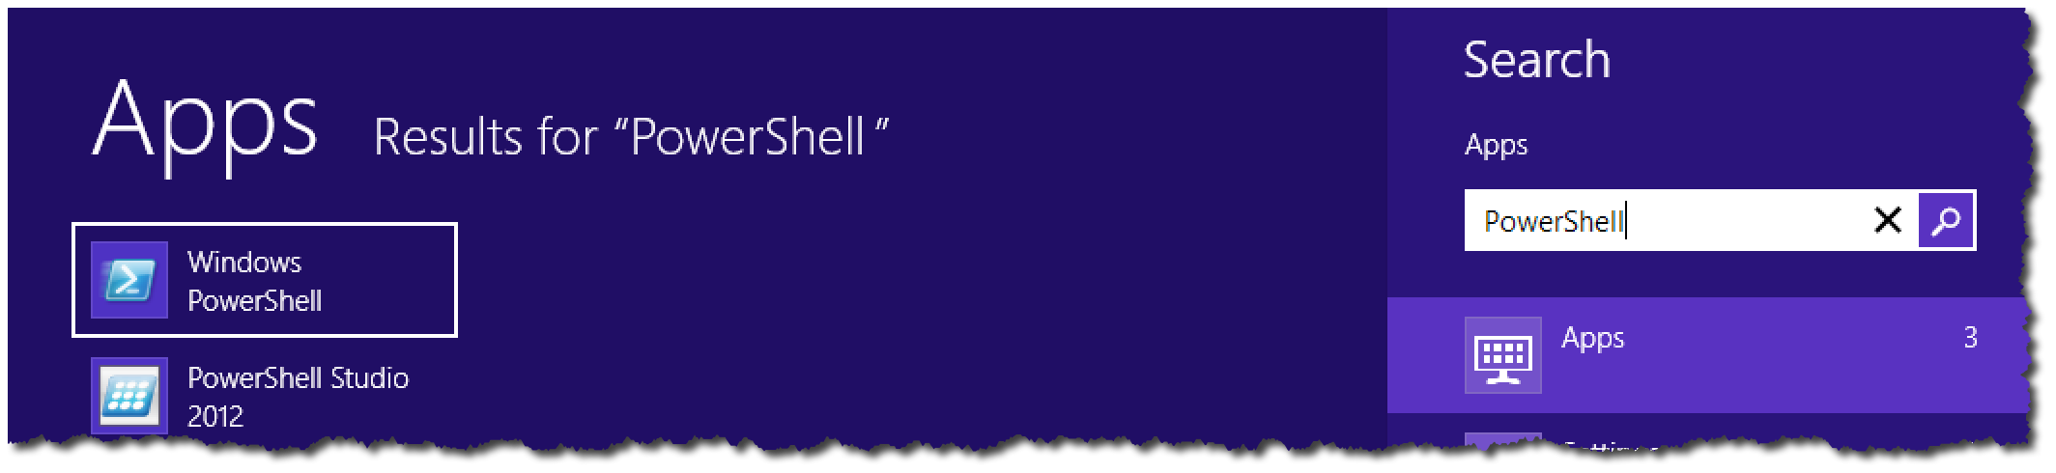
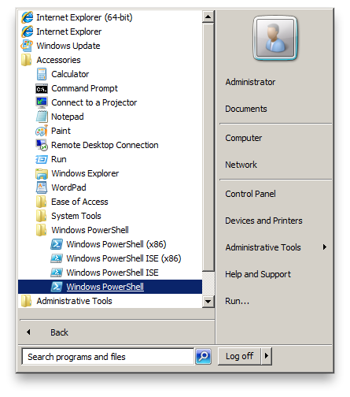

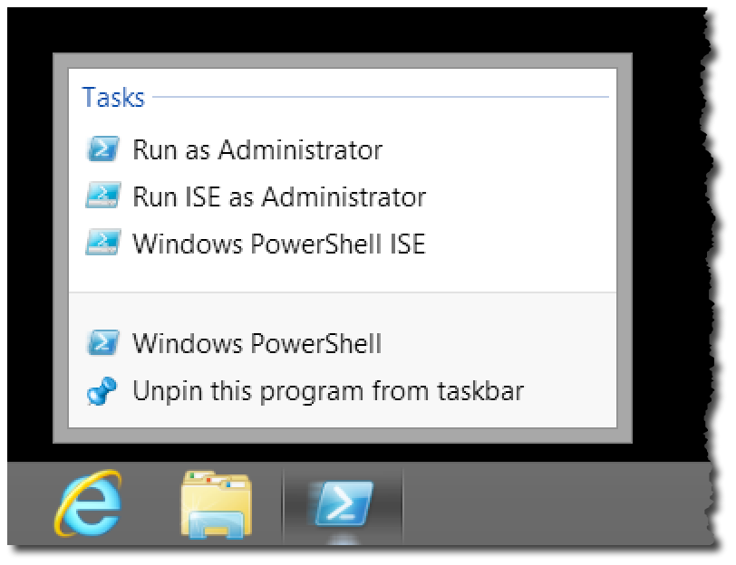
Launching PowerShell for the administrator
01

Slide 7
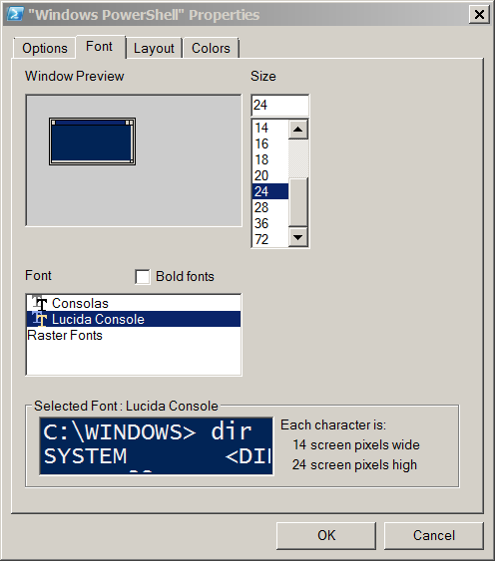
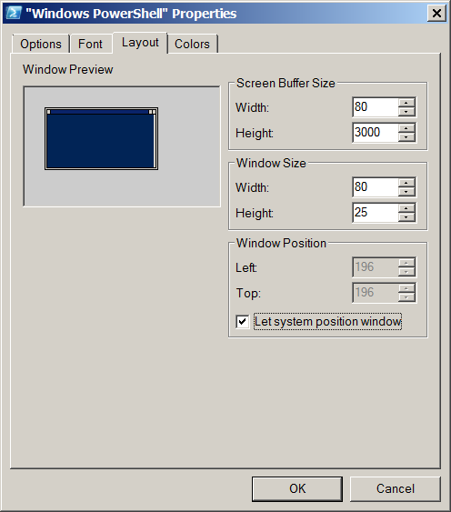
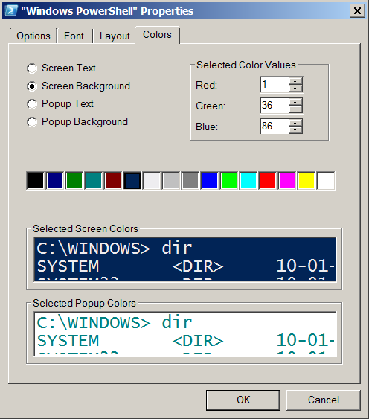
01
Customize the shell for comfort

Slide 8

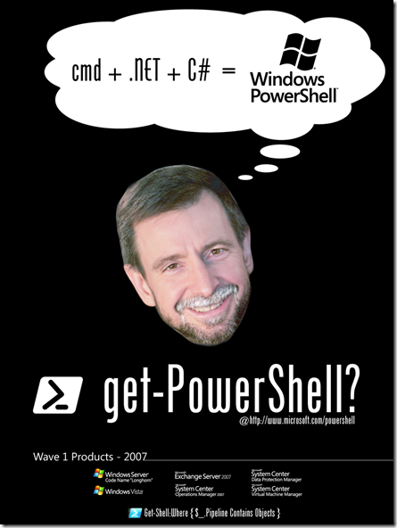
01
Getting familiar with the shell
Cmdlets : Verb – Noun
Native commands work!
Examples – Ping, IPConfig, calc, notepad, mspaint
cls - Clear-Host
cd - Set-Location
dir, ls - Get-Childitem
type, cat - Get-Content
Copy, cp - Copy-item
Jeffrey Snover

Slide 9

02 | The Help system
02
I just heard a double-click. Someone must be in trouble !
KEEP
CALM
AND
USE
GET-HELP

Slide 10
02 | The Help system
02
Why you need help
Updatable Help
Discoverability with the Help system
Understanding Syntax
Real-World using Help

Slide 11
Why you need help ?
02
Vast resource at your finger tips to help make you successful
Don’t memorize – Discover!
Thousands of cmdlets – all have help!
Scripting resources and information
Advanced PowerShell configuration information

Slide 12
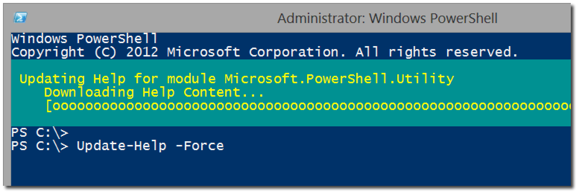
Updatable Help
02
Update to the latest version of Help
Save-Help to save to a local location
- We start by downloading from a machines that has internet access to a local folder or file share the machine has access to
Save-Help –DestinationPath \\internal.uncPath\PSv3Help
- We can move the files to a USB Drive or Share and them from the host that we want to update the help files we specify the –SourcePath and the path to where the files are located
Update-Help –SourcePath \\internal.uncPath\PSv3Help
- We can configure a scheduled task to update each day the PowerShell help files either from the internet or from a share as in the example above:
Register-ScheduledJob -Name UpdatePSHelp `
-ScheduledJobOption @{RunElevated=$true} `
-ScriptBlock {Update-Help -Force -Verbose} `
-Trigger @{At='6:00 AM';Frequency='Daily'}
We can take a look at the output of the scheduled jobs with: Get-Job -Name UpdateHelp | Receive-Job
- Now if you are using PowerShell v2 and you also want the latest help information you can use the –Online parameter and this will open Internet Explorer to the page with the latest information you requested.

Slide 13
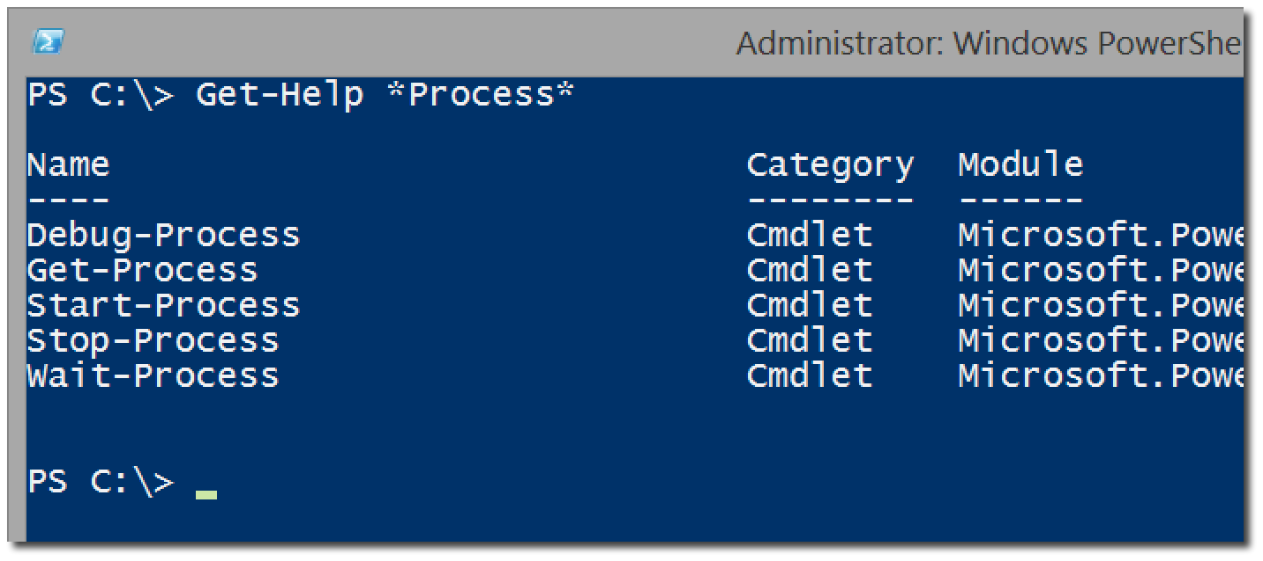
Discoverability with the Help system
02
Get-Help versus Help and Man
Help <cmdlet>
Help *partial*
Help <verb/noun>
Help <cmdlet> -Full
Help <cmdlet> -Online
Help <cmdlet> -ShowWindow
Get-Help About_*

Slide 14
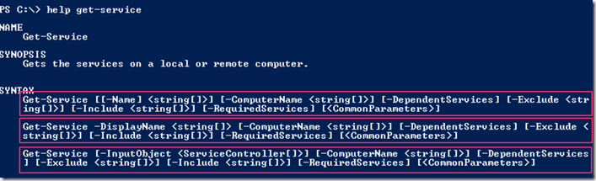
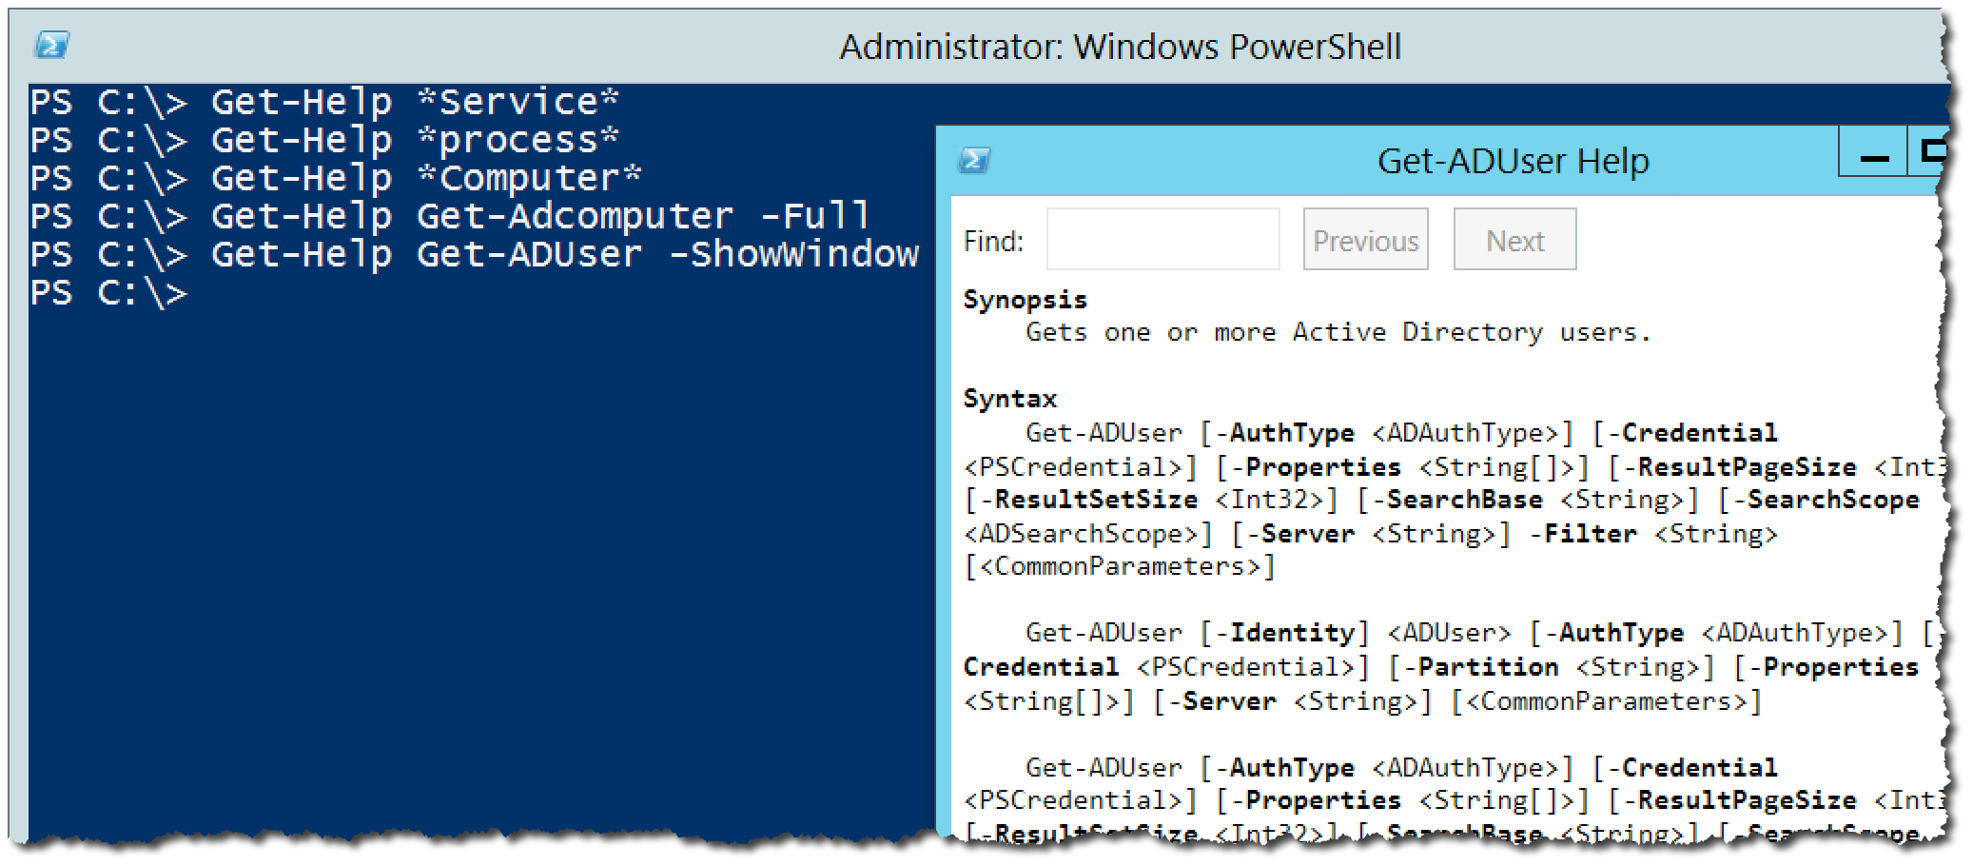
Understanding Syntax
02
The meaning of Syntax
- Indicates A Parameter
<> Indicates Arguments
[] Argument Accepts Multiple Values
[Param] is Positional
[Param Arg] is Optional
- full (detailed help)
required? - specifies if the option is required or not.
position? - specified if the position is a named one or an order one. For ordered one it will give the number of the position for the value it will map to it.
Default value - Default value the option has. (Some times on PSv2 it does not display properly)
Accept pipeline input? - specified if the option accepts input from the pipeline and if the input is by value type or by property name.
Accept Wildcard Characters? - specifies if wildcard characters can be used.
– ShowWindow

Slide 15

03 | The pipeline : Getting connected
03
What’s the pipeline and what does it do?
Exporting/Importing CSV
Exporting/Importing XML
Other files and printers
Displaying information in a GUI
Making a webpage of information
Cmdlets that kill

Slide 16
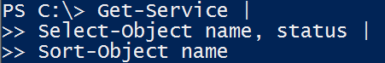
What’s the pipeline and what does it do?
03
Pipe character located above the Enter key |
Connects cmdlets to produce better results
Can be broken into several lines to increase readability

Slide 17
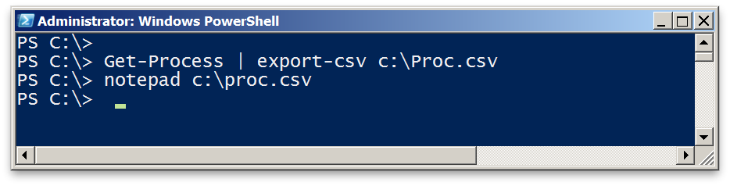
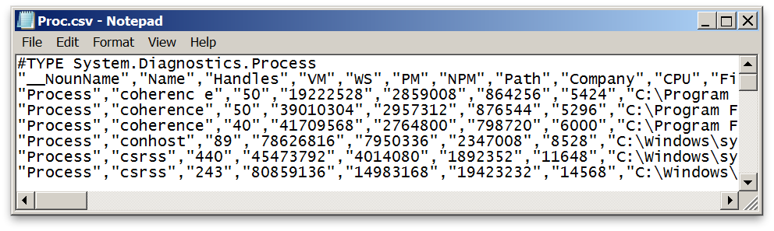
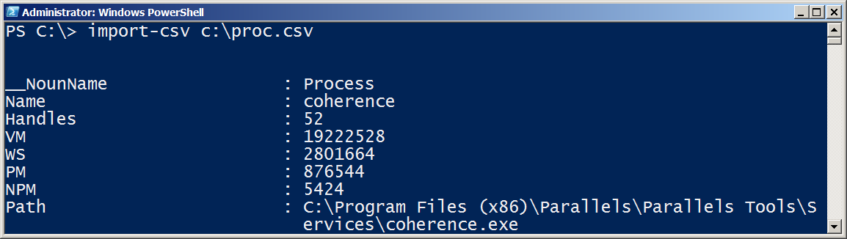
Exporting/Importing CSV
03
get-service | export-csv –path service.csv
notepad service.csv
import-csv service.csv

Slide 18
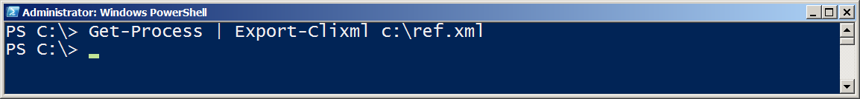
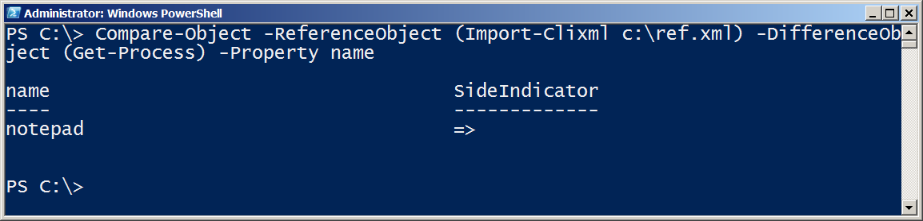
Exporting/Importing XML
03
get-process |export-clixml –path ref.xml
Run: notepad good.xml and calc
Compare-Object -ReferenceObject (Import-Clixml c:\ref.xml) -DifferenceObject (Get-Process) -Property name

Slide 19
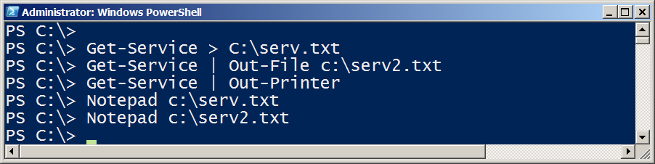
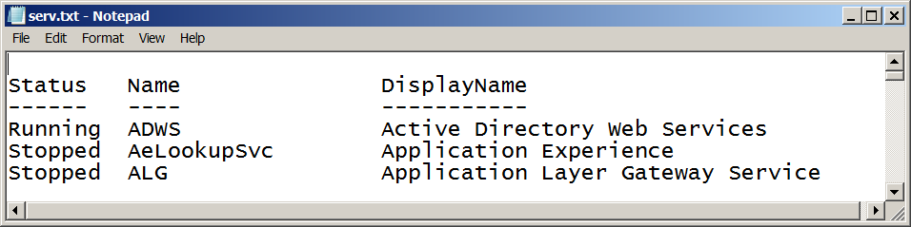

Other files and printers
03

Slide 20
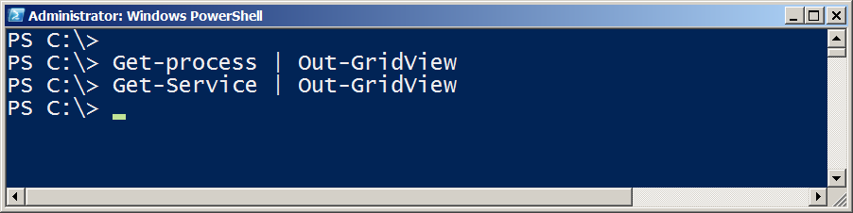
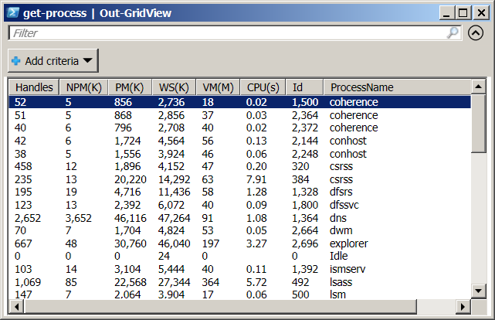
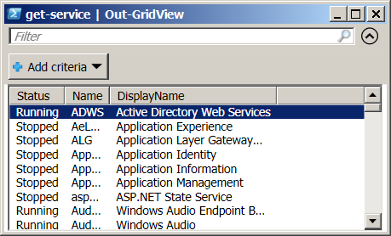
Displaying information in a GUI
03

Slide 21
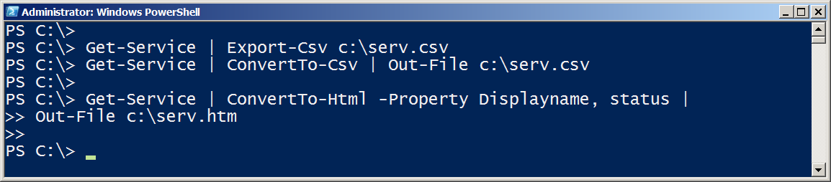
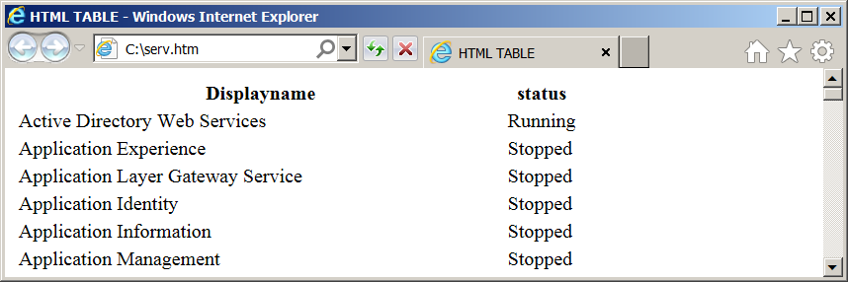
Making a webpage of information
03

Slide 22

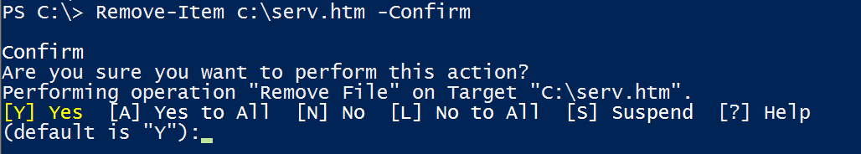
Cmdlets that kill
03
Stop-Process / kill
Stop-service
-Confirm
-Whatif

Slide 23
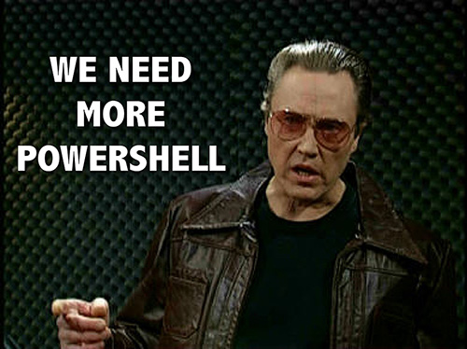
04 | Extending the shell
04
Like the MMC – One Shell does it all
Finding and adding Snap-ins
Finding and adding Modules
Discovering new commands
The real world of cmdlets

Slide 24
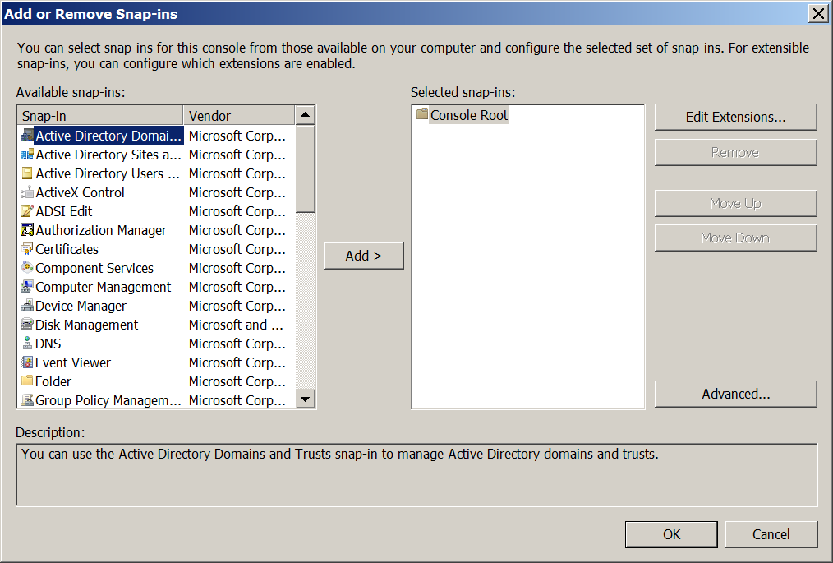
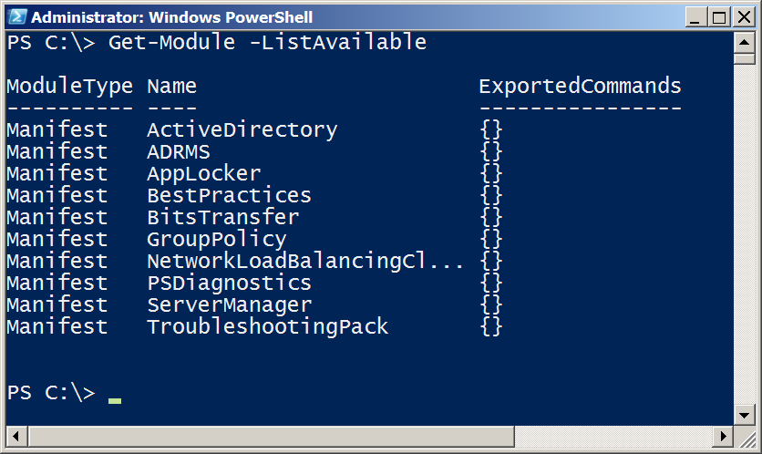
Like the MMC - One Shell does it all
04

Slide 25
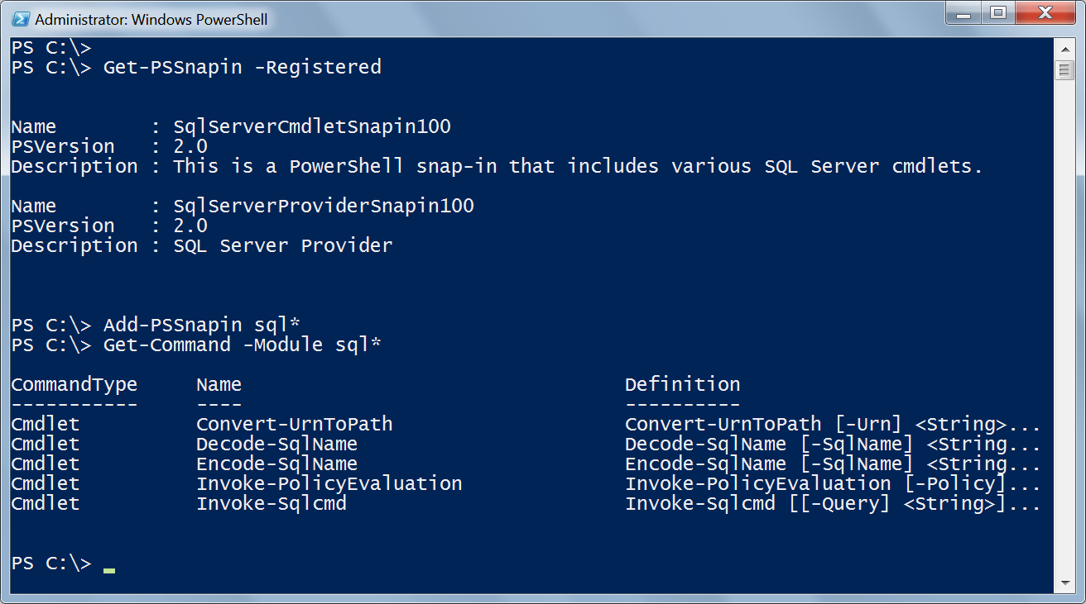
Finding & Adding Snap-ins
04
Add-PSSnapin Microsoft.Exchange.Management.PowerShell.E2010 -ErrorAction SilentlyContinue

Slide 26
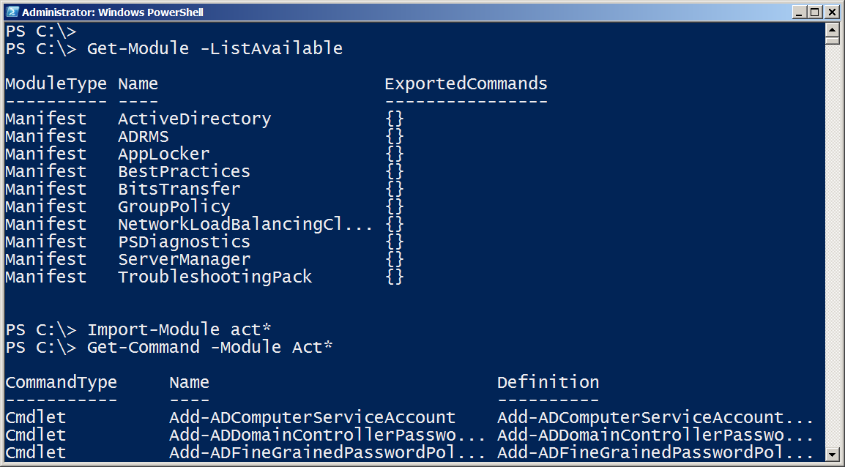
Finding & Adding Modules
04
PowerShell V3 dynamically imports modules when you use the cmdlet

Slide 27
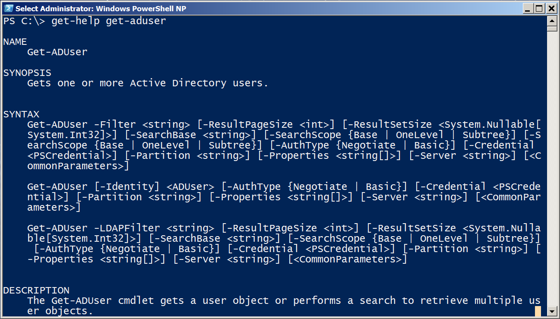
Discovering new commands
04

Slide 28
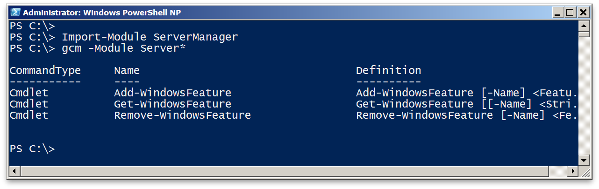
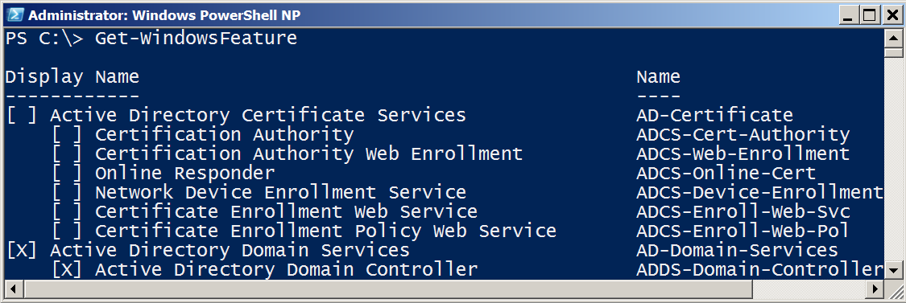
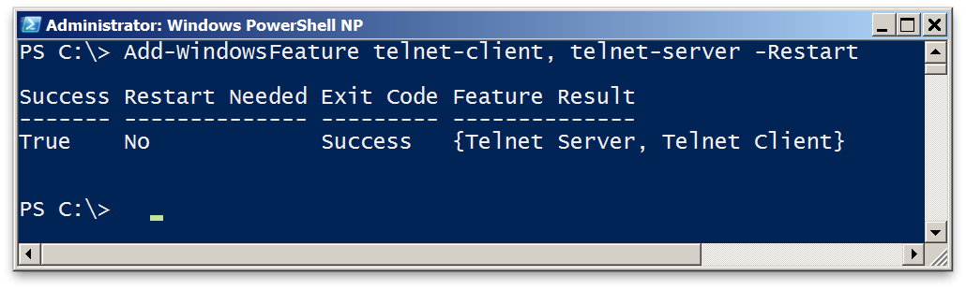
The real world of cmdlets
04

Slide 29
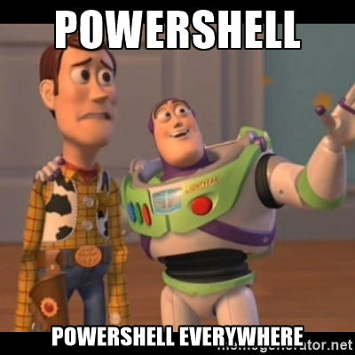
05 | Object for the Admin
05
Object across the pipeline
Getting the information you need
Sorting Objects
Selecting Objects
Custom Properties
Filtering data
Methods – When no cmdlet exists

Slide 30
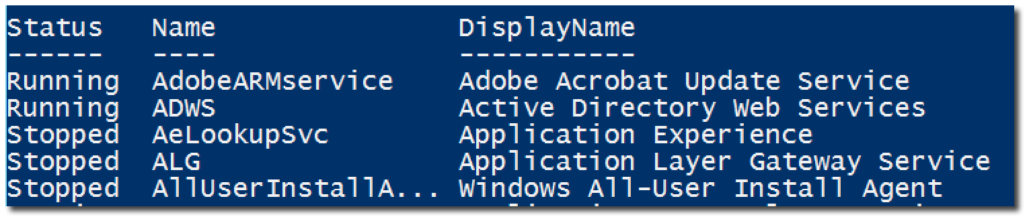
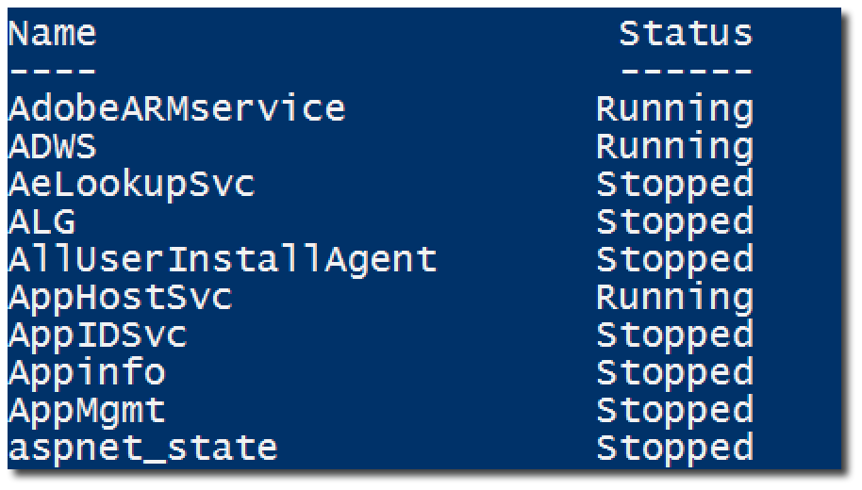
Object across the pipeline
05

Slide 31
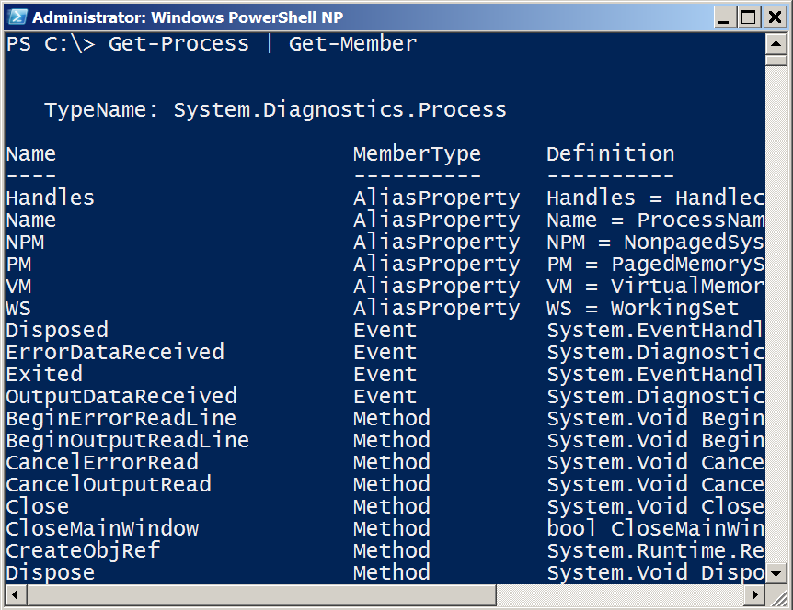
Getting the information you need
05
Get-Member (gm)
TypeName is a unique Windows assigned name
Displays the properties and methods of an object
Properties are potential columns of information
Methods are the potential actions that can be taken

Slide 32
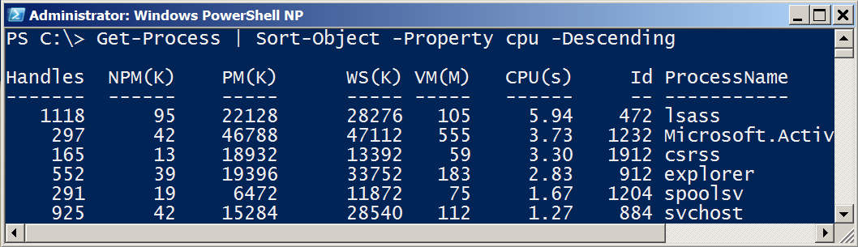
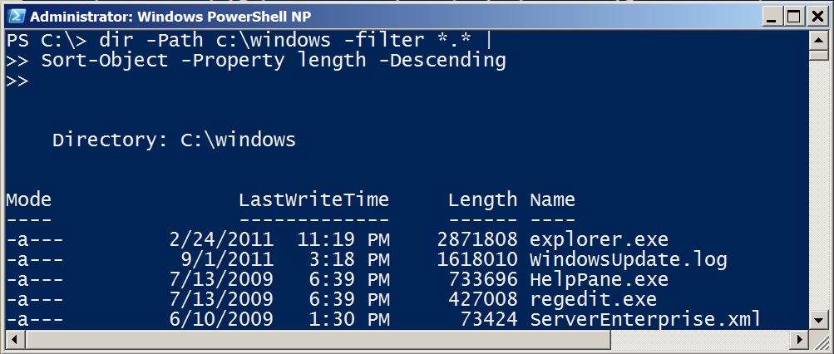
Sorting Objects
05
Sort-Object sorts properties.
Use Get-Member to see a list of properties

Slide 33
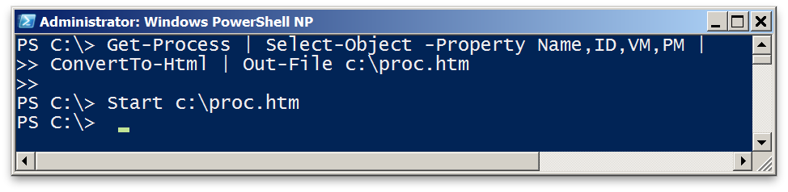
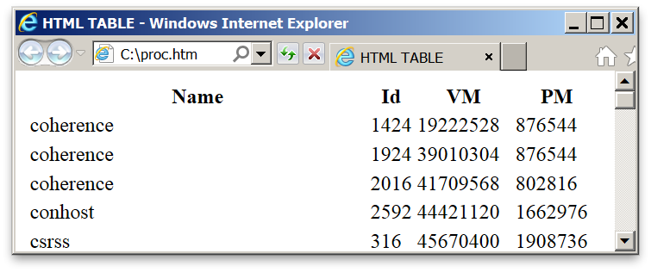
Selecting Objects
05
Select-Object selects properties.
Use Get-Member to list properties to select from.
-first and -last restrict list of rows displayed.

Slide 34
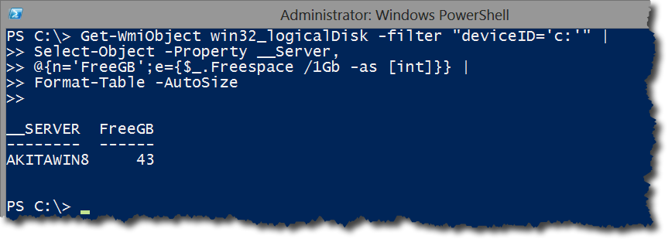
Custom Properties
05

Slide 35
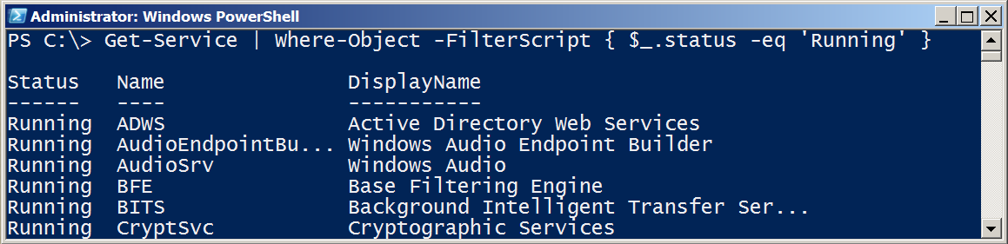
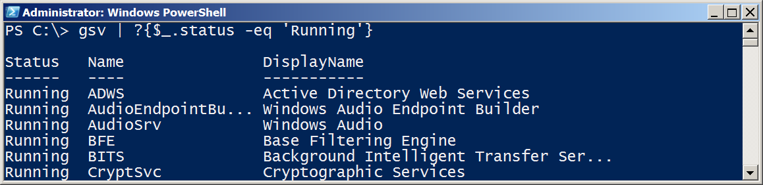
Filter Object Out of the Pipeline
05

Slide 36
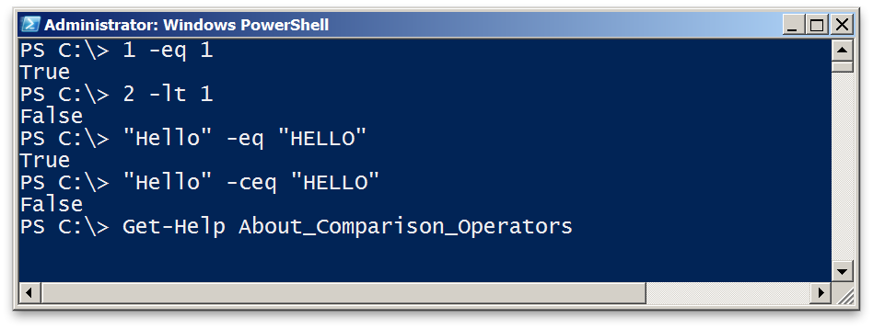
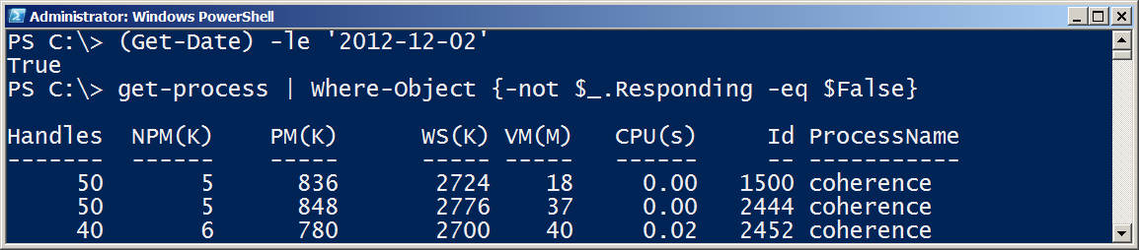
Comparison Operators
05
Comparison returns boolean True or False
Comparison can be case-sensitive using ‘c’ prefix
For complete description, see About_Comparison

Slide 37
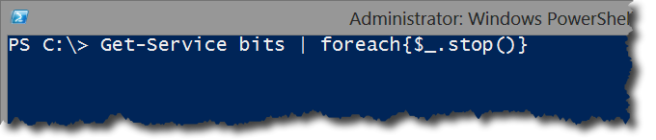
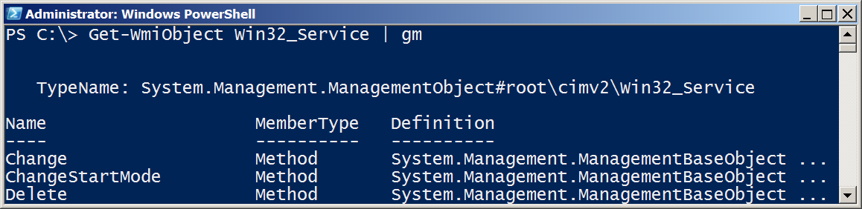
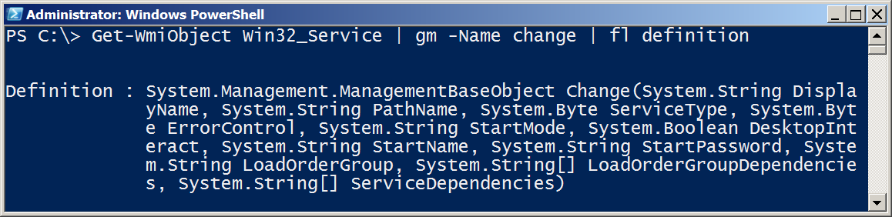

Methods – When no cmdlet exists
05

Slide 38

06 | The Pipeline : Deeper
06
How the pipeline really works - The 4 step solution
ByValue
ByPropertyName
What if my property doesn’t match – Customize it!
The Parenthetical – when all else fails

Slide 39
How the pipeline really works
06

Slide 40



1- ByValue
06
1. Get-Service passes ServiceController objects to the pipeline
2. Does Stop-Service accept ServiceController Objects?
3. Help Stop-Service -Full
displays a parameter that accepts ServiceController ByValue

Slide 41








2- ByPropertyName
06

Slide 42




3- ByPropertyName
06
1. Get-Process is passing a “Process” Object
2. Stop-Service does not support accepting “Process” objects ByValue, so PowerShell checks what can be accepted ByPropertyName.
3. -Name does accept strings ByPropertyName, and the objects in the pipeline are labeled as a Name property
4. Stop-Service attempts to use the objects for its -Name, in this example, fails

Slide 43


4- What if my property doesn’t match – Customize it
06

Slide 44



The Parenthetical – when all else fails
06
1. I want to pass a list of computer names to Get-Service. Why does this fail?
2. -Name and -InputObject accept pipeline input ByValue, not -Computername. -Name accepts text, and then causes the failure.
Parenthesis don’t rely on binding and attach information directly to the desired parameter.

Slide 45






The Parenthetical – when all else fails
06
Returns a collection (table)
of objects.
Returns string contents

Slide 46

07 | The Power in the Shell - Remoting
07
Overview of Remoting
Enable Remoting
One-To-One
One-To-Many
Not the end yet!

Slide 47











Overview of Remoting
07

Slide 48



Enable Remoting
07
PowerShell Remoting is already enabled in Server 2012
Computer Configuration/Policies/Administrative Templates/Windows Components/Windows Remote Management

Slide 49

One to One - Interactive
07

Slide 50


One-To-Many
07

Slide 51

PowerShell Web Access
08
PowerShell – Anywhere, anytime, on any device!
Install-WindowsFeature –Name WindowsPowerShellWebAccess
Get-Help *Pswa*
Install-PswaWebApplication –UseTestCertificate
# Use the –useTestCertificate for testing (Expires in 90 days)
Add-PswaAuthorizationRule –userName <Domain\User | Computer\user> -ComputerName <Computer> -ConfigurationName AdminsOnly

Slide 52

08 | Getting prepared for automation
08
PowerShell security goals
Execution Policy
Variables : a place to store stuff
Fun with Quotes
Getting and displaying input
Other output for scripts and automation

Slide 53

PowerShell security goals
08
Secured by default
Prevents mistakes by unintentional admins and users
No Script Execution
.Ps1 associated with notepad
Must type path to execute a script

Slide 54


Execution Policy
08
By default, PowerShell does not run scripts.
Get/Set-ExecutionPolicy
Restricted
Unrestricted
AllSigned
RemoteSigned
Bypass
Undefined
Can be set with Group Policy

Slide 55




Variables: A place to store stuff
08
Use $ to create and use variables
Can contain letters, numbers, spaces and underscores
Don’t persist after Shell exits
New-Variable
Set-Variable
Get-Variable
Clear-Variable
Remove-Variable
Can force a type – [int]$var
Note: The $ is not part of the variable name,
it’s a cue to access the contents of the variable

Slide 56

Fun with Quotes
08
Double Quotes resolve all variables
Can use Sub-Expressions
Single Quotes prevent substitution
Get-Help About_Quoting_Rules
Back-tick/Grave-Accent prevents individual substitution

Slide 57



Getting and displaying input
08

Slide 58

Other output for scripts and automation
08
Write-Warning
Write-Verbose
Write-Debug
Write-Error
$Preference variables to know
Help about_Preference_Variables
$DebugPreference=SilentlyContinue
$ErrorActionPreference=Continue
#VerbosePreference=SilentlyContinue

Slide 59

09 | Automation in scale - Remoting
09
Reusable Sessions
Sessions with Invoke-Command
Getting commands from anywhere

Slide 60


Reusable Sessions
09
Can be disconnected and reconnected in PowerShell V3

Slide 61


Sessions with Invoke-Command
09

Slide 62

Getting commands from anywhere - Implicit Remoting
09

